Slide 1

SRI CHANDRASEKHARENDRA SARASWATHI VISWA MAHAVIDHYALAYA (Deemed to be university u/s 3 of UGC act 1956) (Accredited with “A” by NAAC) Enathur, Kanchipuram – 631561. Tamilnadu www.kanchiuniv.ac.in Department of Computer Science and Engineering
TOPIC : Azure Active Directory in Authentication & Authorization (MFA)
11229A026 - Meyrina D
11229A050 - Vibhu Shreesh H S
GUIDED BY:
JEEVAN DHAMODHARAN
ASSISTANT PROFESSOR CSE

Slide 2


Azure Active Directory: Authentication and Authorization with MFA
In contemporary businesses, protecting valuable resources is essential. This presentation discusses how Active Directory (AD) combines with Multi-Factor Authentication (MFA) to enhance authentication and authorization. AD handles identities, whereas MFA provides a security factor (e.g., mobile app or OTP) to authenticate users, preventing credential stealing. This approach strikes the perfect balance between security and usability, perfect for protecting systems and information.
by Vibhu

Slide 3
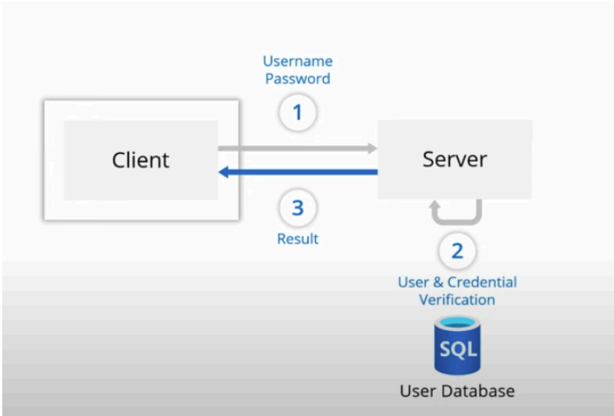
Introduction to AD and MFA
Active Directory (AD)
Multi-Factor Authentication (MFA)
A trusted pillar of identity management, AD verifies user identities and enforces role-based access.
MFA adds a vital layer of defense, ensuring only authenticated individuals pass through with a second proof of trust.
.
Together, they create a streamlined, secure framework—protecting resources with efficiency and elegance

Slide 4

Disadvantages of AD and MFA
Implementation Complexity
Cost Implications
Extra licensing costs (e.g., Azure AD Premium) and infrastructure overhead add expenses.
Requires technical skills for configuration and integration. Misconfigurations lead to security problems.
User Experience Challenges
Resistance to change and MFA fatigue can hinder productivity.

Slide 5




Advantages of AD and MFA
Improved Security
Centralized Identity Management
Fine-grained Authorization
MFA limits unauthorized access and counteracts attacks such as phishing and brute force.
Role-based access control (RBAC) and conditional access provide least-privilege access.
AD simplifies user and permission management within on-premises and cloud environments.

Slide 6
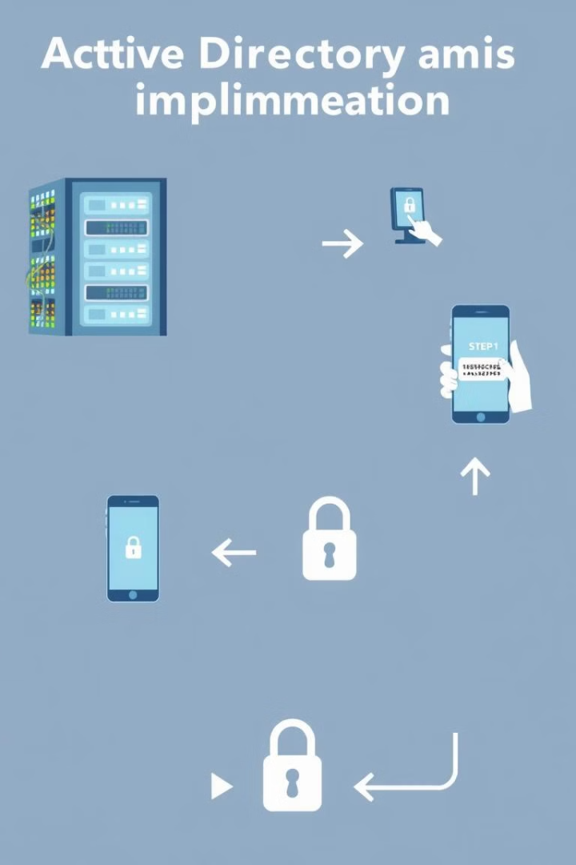




Methodologies for Implementation
Plan & Assess
Establish goals, evaluate risks, audit infrastructure, and align stakeholders.
Design & Architecture
AD Structure, set up MFA, cloud services integration, and policy set.
Implementation
Pilot test, rollout in phases, sync AD, and onboard users with training.
Agile Iteration
Collect feedback, revise policies, test adjustments, and constantly improve.

Slide 7
Procedural Steps for Setup
Prerequisites
1
Verify AD setup, select an MFA solution, and confirm required licenses.
Installation & Configuration
2
Install MFA solution, configure AD user attributes, and set up MFA policies.
Enable & Enroll Users
3
Switch MFA in Azure AD or third-party admin portal; users sign up authenticator methods.

Slide 8
Testing, Monitoring, and Optimization
Testing & Monitoring
Optimization & Security
Confirm MFA prompts for essential systems.
Fine-tune the MFA policies.
Monitor logs (Azure AD, Windows Event Viewer, or third-party dashboards).
Optimize for trusted devices.
Regularly watch for security issues.
These steps ensure that the system is not only secure but also efficient and user-friendly.

Slide 9

Conclusion: AAD with MFA
Azure Active Directory (AAD) with MFA provides secure authentication for hybrid and multi-cloud environments. It protects access, enforces policies, and integrates with platforms like AWS. While similar to AWS IAM and Cognito, AAD's deep Microsoft integration and identity-driven security make it a strong choice for enterprises.

Slide 10
THANK YOU

